Slide 1
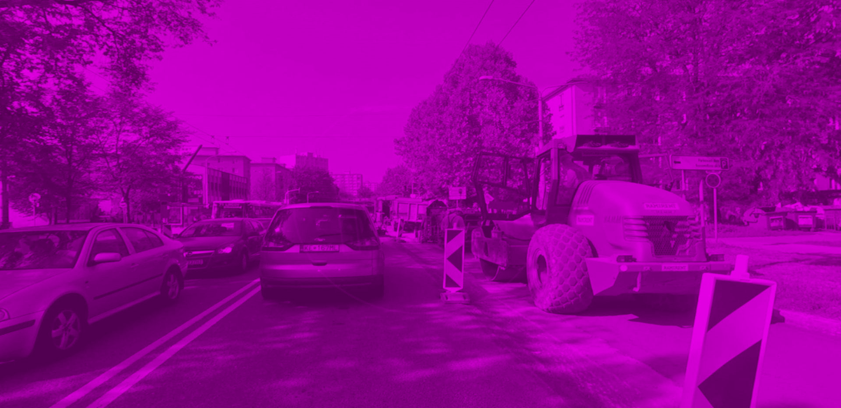





MOBILITY
SMARTER
EVERY
DAY
CITYTHON KOŠICE 2022
MAREK HORVÁTH, TOMÁŠ KORMANÍK, TOMÁŠ GORDOŇ, MATÚŠ TÓTH, DANIEL CHOVANEC

Slide 2

Traffic Jams
More fuel wasted pointlessly
Excess CO2
Environment quality decrease
Lesser public transport usage
KOŠICE
HAS DAILY ISSUES WITH TRAFFIC

Slide 3
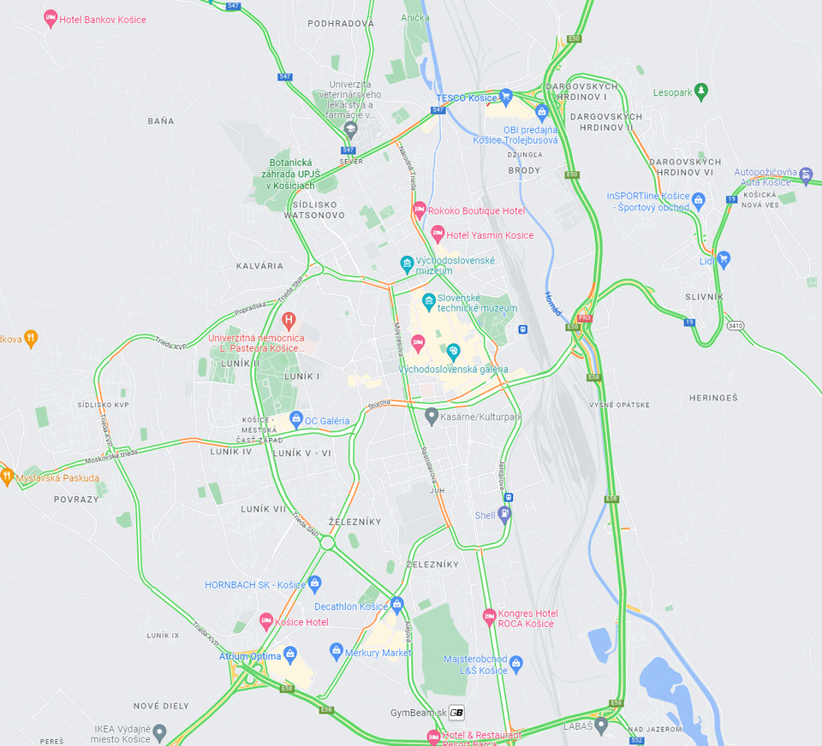
TRAFFIC LOAD
VISUALIZATION
DURING
COMMON
WORKDAY
THE MOST TRAFFIC HEATMAP IN THE CITY OF KOŠOCE (4.12.2022)
SOURCE: GOOGLE TRAFFIC API

Slide 4
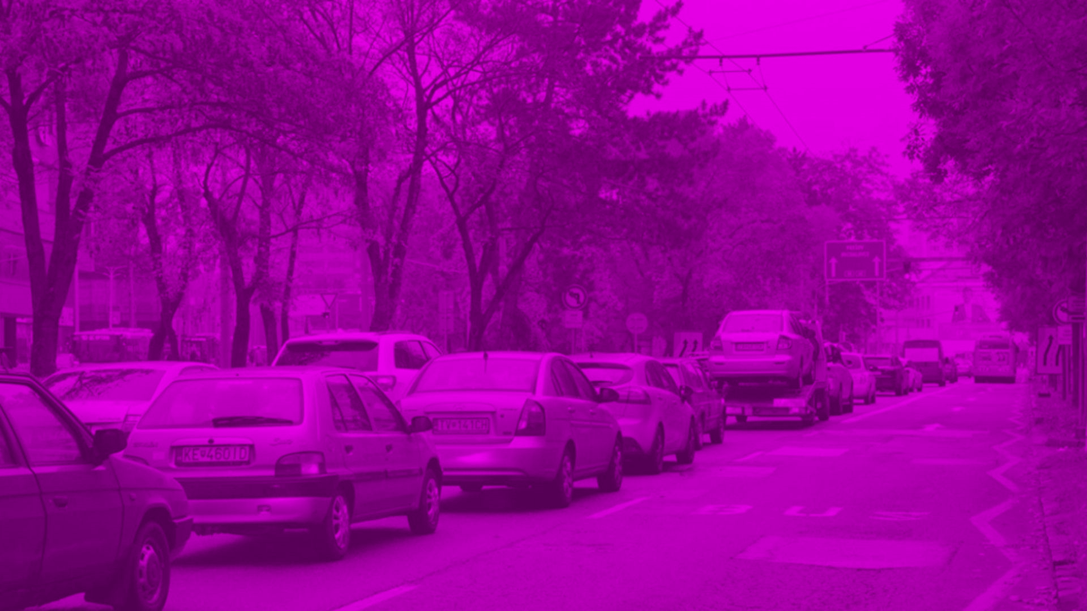
1
ST
SMART SOLUTION FOR BALACING TRAFFIC IN EASTERN SLOVAKIA

Slide 5
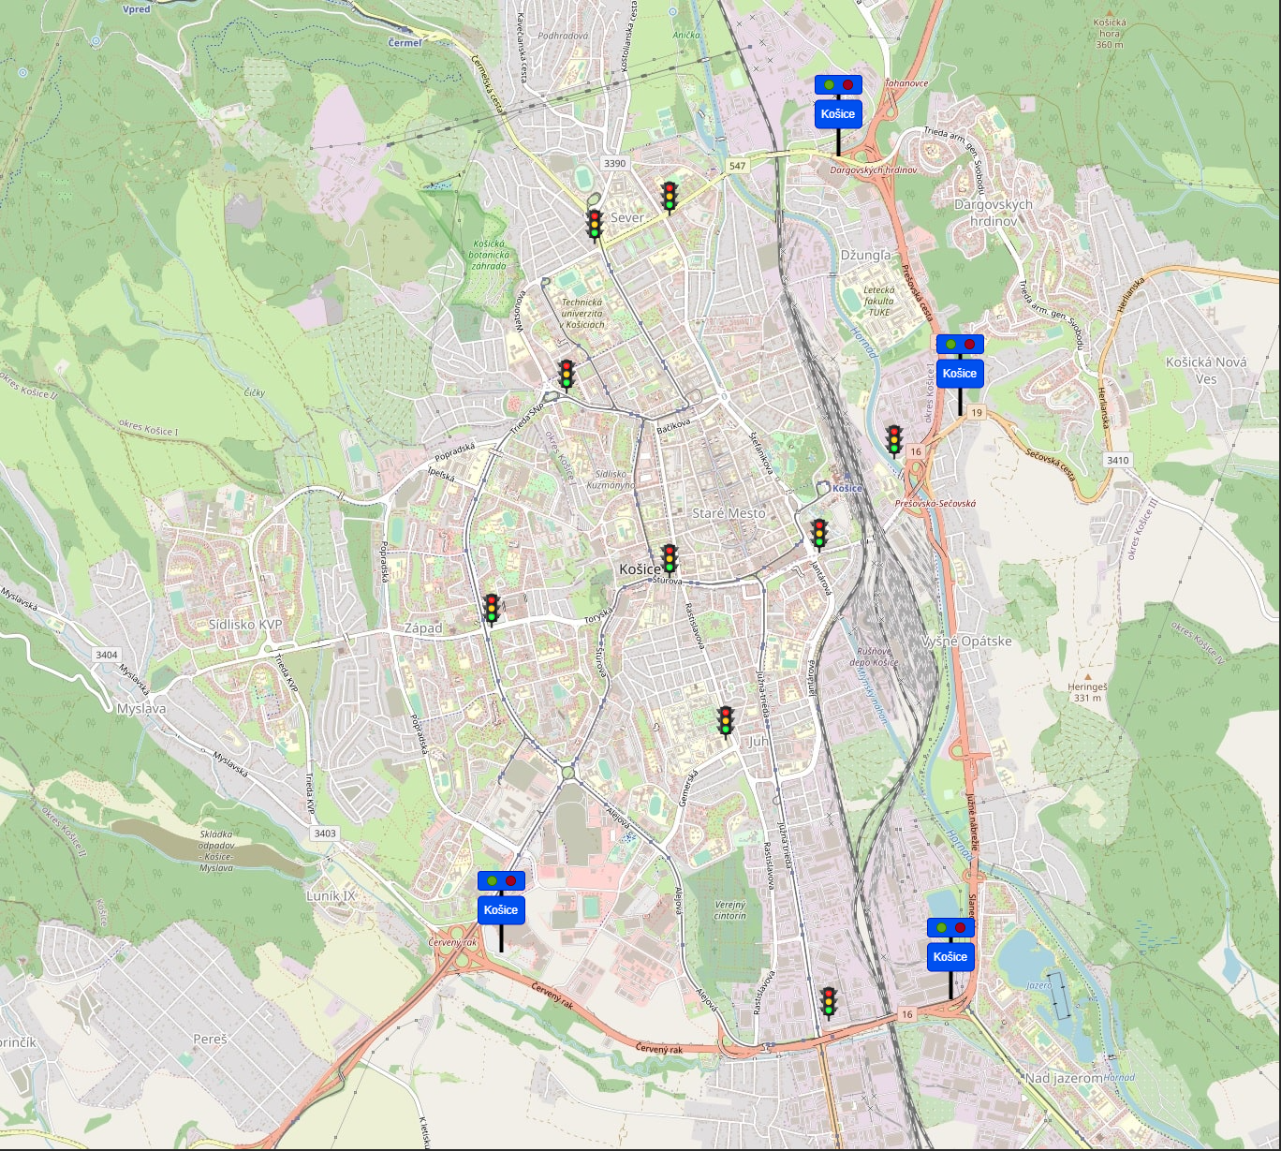
STRATEGIC
DISTRIBUTION OF IoT ELEMENTS OF OUR SOLUTION

Slide 6
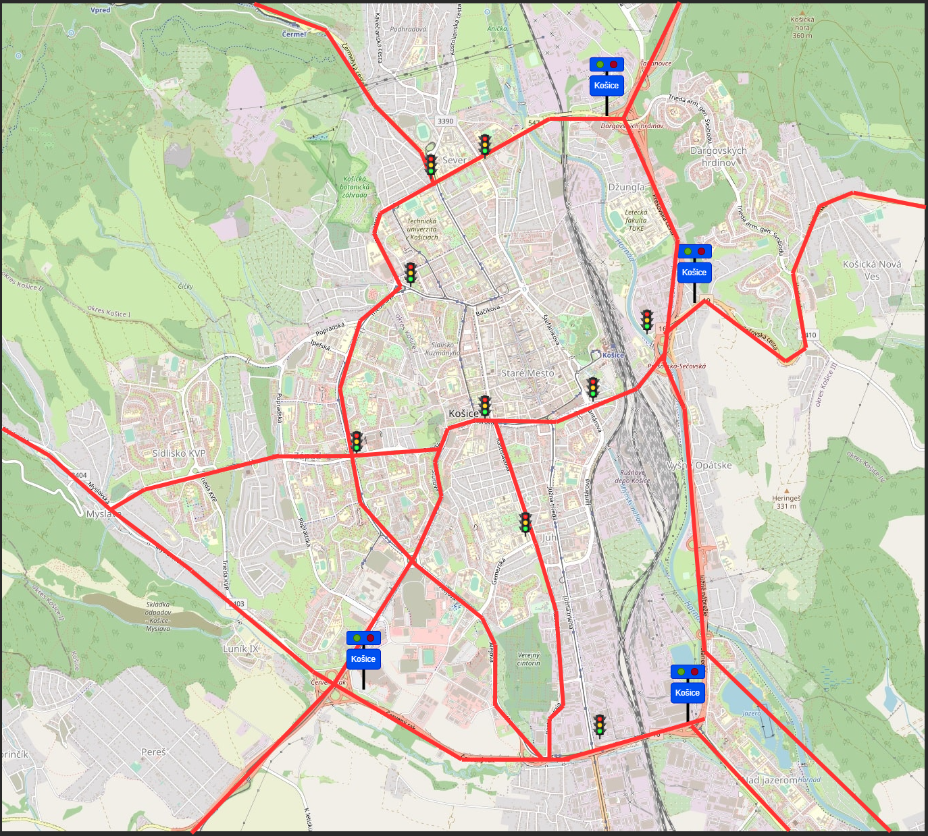
KEY INFRASTRUCTURE NET CONTAINTING
ALL MAJOR
CHOKE POINTS
GENERATED THANKS TO DATA

Slide 7
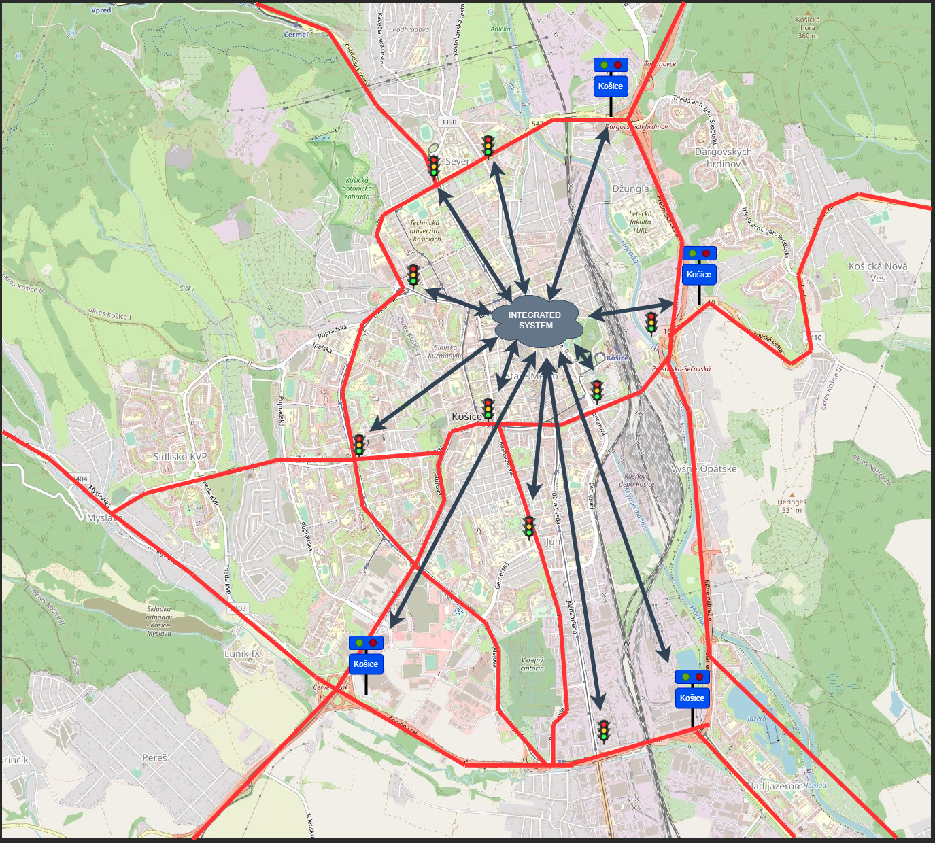
CITYWIDE DATA
COLLECTING
AND IoT
INTEGRATION

Slide 8
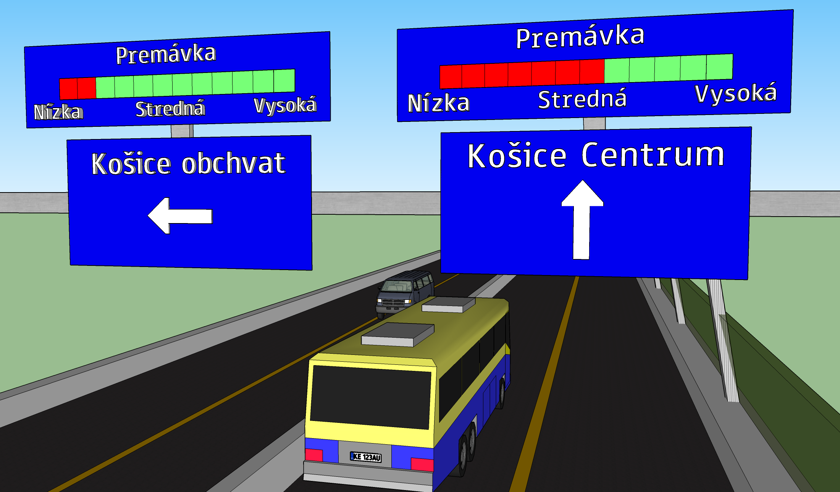

Slide 9
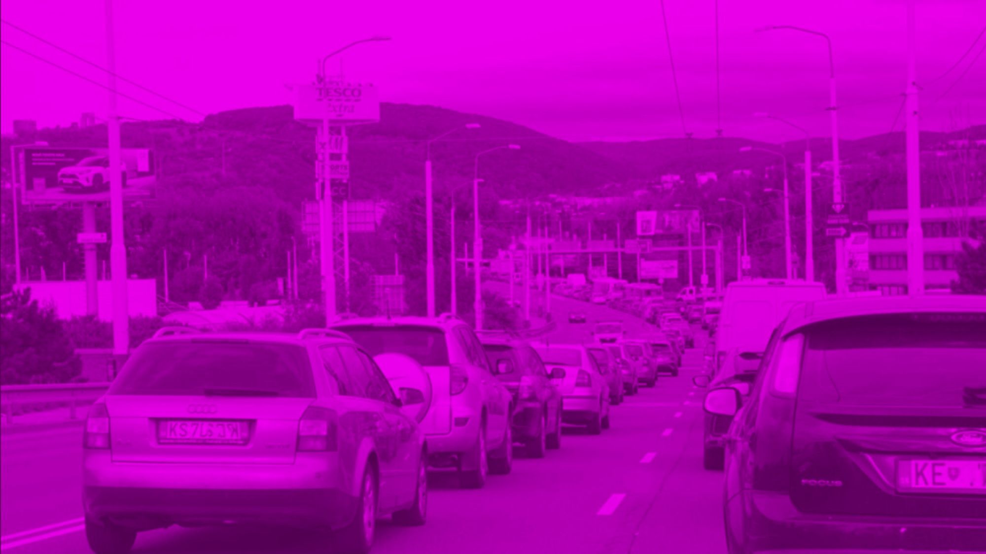
BENEFITS
Enhanced data about traffic in city
2
CO
Emissions reduction
Logistics and public transport optimalization
Crisis handling optimalization

Slide 10
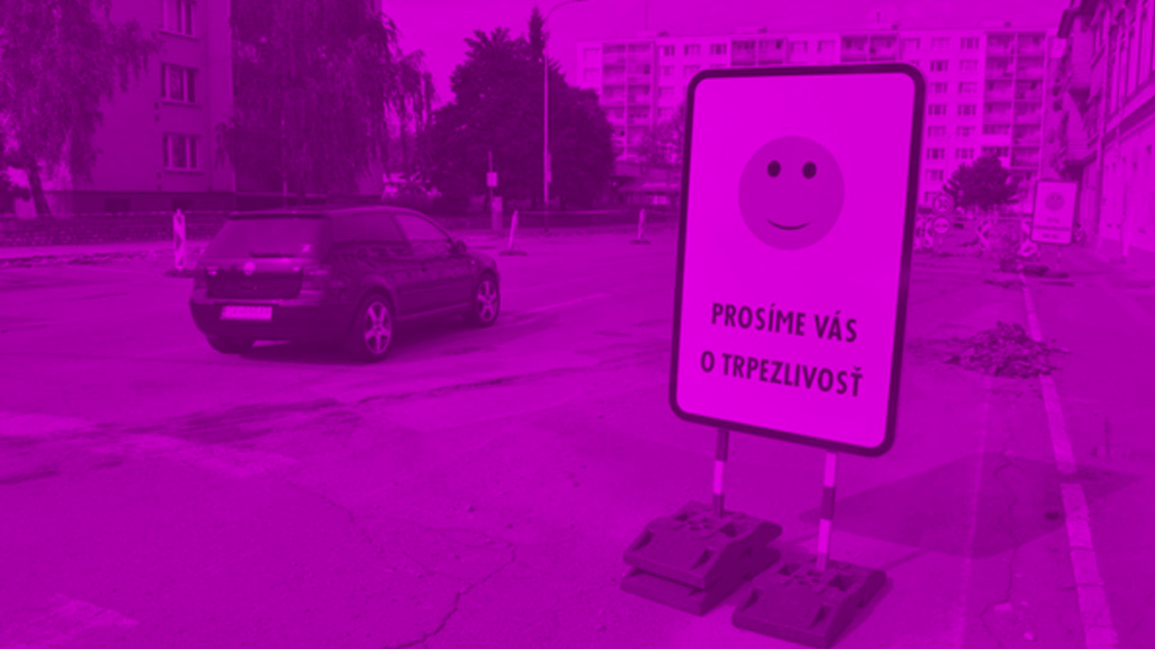
QUESTIONS?

